Slide 1
Disinfection and Sterilization:
What’s New?
William A. Rutala, PhD, MPH
Director, Hospital Epidemiology, Occupational Health and Safety at UNC Health Care; Research Professor of Medicine and Director, Statewide Program for Infection Control and Epidemiology at University of North Carolina School of Medicine at Chapel Hill, USA

Slide 2
DISCLOSURES
Consultation
  ASP (Advanced Sterilization Products)-2014, Clorox-2014, 2015
Honoraria (2014, 2015)
  3M, ASP, Clorox
Grants
  CDC, CMS, Nanosonics

Slide 3
HLD and Sterilization: What’s New?
  Sterilization
    Biological indicators, emerging technologies, modified Spaulding classification
  High-Level Disinfection
    Endoscope-related infections, channeled scopes, reuse of single-use items
  Low-Level Disinfection
    Emerging pathogens, room decontamination methods

Slide 4
www.disinfectionandsterilization.org

Slide 5
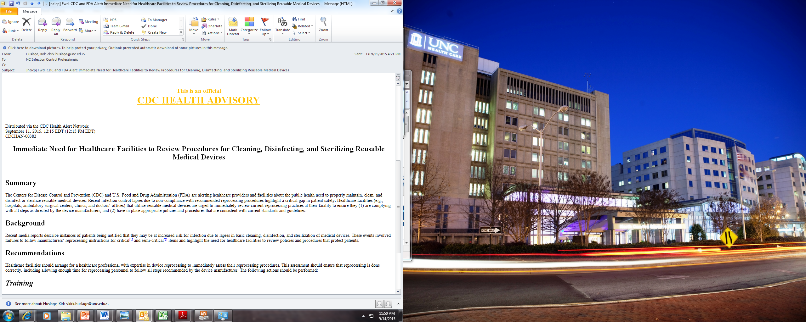
Health Care Facilities Need to Immediately Medical Device Reprocessing Procedures
Train Staff, Audit Adherence to Steps, Provide Feedback on Adherence

Slide 6
Health Care Facilities Need to Immediately Medical Device Reprocessing Procedures
Reprocessing lapses resulting in patient infections and exposures
Healthcare facilities urged to immediately review current reprocessing practices to ensure comply with device manufacturer and guidelines
  Training (upon hire and at least annually), demonstrate and document competency
  Audit should assess all reprocessing steps including cleaning, disinfectants (conc, contact time), sterilizer (chemical, biological indicators). Feedback from audits to personnel regarding adherence.

Slide 7
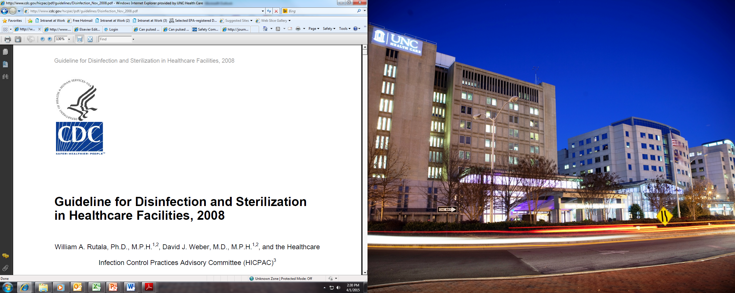
CDC Guideline for Disinfection and Sterilization
Rutala, Weber, HICPAC. November 2008. www.cdc.gov

Slide 8
HLD and Sterilization:
What’s New
  Sterilization
    Biological indicators, emerging technologies, modified Spaulding classification
  High-Level Disinfection
    Endoscope-related infections, channeled scopes, reuse of single-use items
  Low-Level Disinfection
    Emerging pathogens, room decontamination methods

Slide 9
Sterilization of “Critical Objects”
Steam sterilization
Hydrogen peroxide gas plasma
Ethylene oxide
Ozone
Vaporized hydrogen peroxide
Steam formaldehyde

Slide 10
Ozone and Hydrogen Peroxide
Sterizone VP4, 510(k) FDA clearance,TSO₃ Canada
Sterilizer has a 4.4ft³ chamber
Advantages/Disadvantages-not yet known

Slide 11
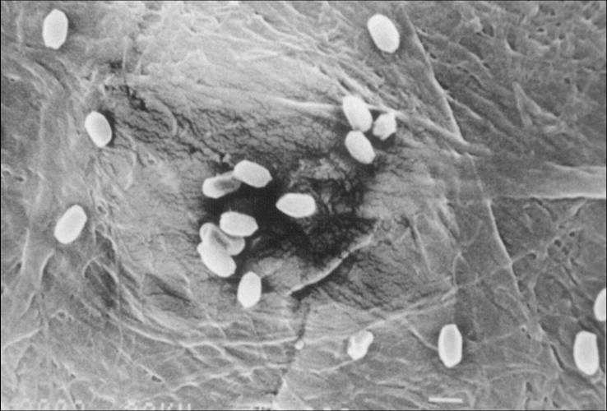
Biological Indicators
Select BIs that contain spores of Bacillus atrophaeus
  Rationale: BIs are the only
  sterilization process monitoring
  device that provides a direct measure of the lethality of the process
Bacillus atrophaeus
Notes:
BI: “Test system containing viable microorganisms providing a defined resistance to a specified sterilization process.”
Remind audience that this is a different spore than that used to monitor steam sterilization processes

Slide 12
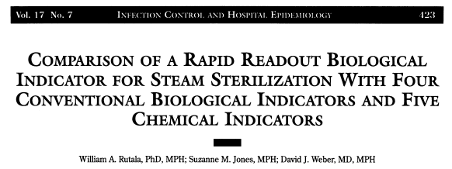
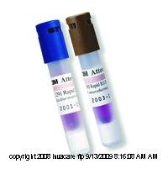
Rapid Readout BIs for Steam Now Require a 1-3h Readout Compared to 24-48h
Rutala, Jones, Weber ICHE 1996. 17:423

Slide 13
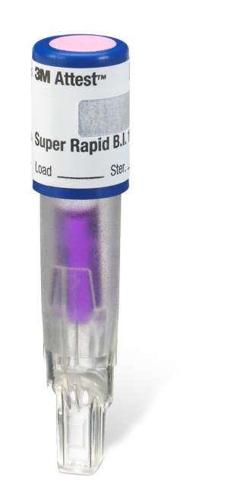
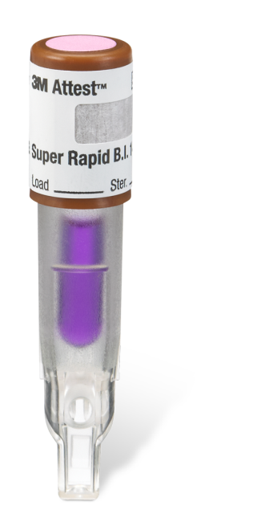
Super Rapid Readout Biological Indicators
Commercially available
1491 BI (blue cap)
Monitors 270°F and 275°F gravity –displacement steam sterilization cycles
30 minute result (from 1hour)
1492V BI (brown cap)
Monitors 270°F and 275°F dynamic-air-removal (pre-vacuum) steam sterilization cycles
1 hour result (from 3 hours)

Slide 14
RECENT ENDOSCOPY-RELATED OUTBREAKS OF MRDO WITHOUT REPROCESSING BREACHES
MDRO | Scope | No. | Recovered From Scope | Molecular Link | Reference
P. aeruginosa (VIM-2) | Duodenoscope | 22 | Yes, under forceps elevator | Yes | Verfaillie CJ, 2015
E. coli (AmpC) | Duodenoscope | 7 | Yes (2 scopes) | Yes (PFGE) | Wendort, 2015
K. pneumoniae (OXA) | Duodenoscope | 5 | No |  | Kola A, 2015
E. coli (NDM-CRE) | Duodenoscope | 39 | Yes | Yes (PFGE) | Epstein L, 2014
Additional Outbreaks (not published; news media reports)
UCLA, 2015, CRE, 179 patients exposed (2 deaths), 2 colonized duodenoscopes
CMC, 2015, CRE, 18 patients exposed (7 infected), duodenoscopes
Cedars-Sinai, 2015, CRE, 67 patients exposed (4 infected), duodenoscopes
Wisconsin, 2013, CRE, (5 infected), duodenoscopes
University of Pittsburgh, 2012, CRE, 9 patients, duodenoscopes

Slide 15
FDA Panel, May 2015, Recommended Sterilization of Duodenoscopes
(requires FDA-cleared technology that achieves a SAL 10⁻⁶ with duodenoscopes)

Slide 16
Disinfection and Sterilization
WA Rutala, DJ Weber, and HICPAC, www.cdc.gov
EH Spaulding believed that how an object will be disinfected depended on the object’s intended use.
CRITICAL - objects which enter normally sterile tissue or the vascular system or through which blood flows should be sterile.
SEMICRITICAL - objects that touch mucous membranes or skin that is not intact require a disinfection process (high-level disinfection [HLD]) that kills all microorganisms but high numbers of bacterial spores.
NONCRITICAL -objects that touch only intact skin require low-level disinfection (or non-germicidal detergent).

Slide 17
Disinfection and Sterilization
WA Rutala, DJ Weber, and HICPAC, www.cdc.gov
EH Spaulding believed that how an object will be disinfected depended on the object’s intended use (modified).
CRITICAL - objects which directly or secondarily (i.e., via a mucous membrane such as duodenoscope) enter normally sterile tissue or the vascular system or through which blood flows should be sterile.
SEMICRITICAL - objects that touch mucous membranes or skin that is not intact require a disinfection process (high-level disinfection [HLD]) that kills all microorganisms but high numbers of bacterial spores.
NONCRITICAL -objects that touch only intact skin require low-level disinfection (or non-germicidal detergent).

Slide 18
HLD and Sterilization:
What’s New
  Sterilization
    Biological indicators, emerging technologies, modified Spaulding classification
  High-Level Disinfection
    Endoscope-related infections, channeled scopes, reuse of single-use items
  Low-Level Disinfection
    Emerging pathogens, room decontamination methods

Slide 19
DISINFECTION AND STERILIZATION
EH Spaulding believed that how an object will be disinfected depended on the object’s intended use
  CRITICAL - objects which enter normally sterile tissue or the vascular system or through which blood flows should be sterile
  SEMICRITICAL - objects that touch mucous membranes or skin that is not intact require a disinfection process (high-level disinfection[HLD]) that kills all microorganisms except for high numbers of bacterial spores
  NONCRITICAL - objects that touch only intact skin require low-level disinfection

Slide 20
High-Level Disinfection of
“Semicritical Objects”
Exposure Time > 8m-45m (US), 20ºC
Germicide Concentration_____
Glutaraldehyde > 2.0%
Ortho-phthalaldehyde 0.55%
Hydrogen peroxide* 7.5%
Hydrogen peroxide and peracetic acid* 1.0%/0.08%
Hydrogen peroxide and peracetic acid* 7.5%/0.23%
Hypochlorite (free chlorine)* 650-675 ppm
Accelerated hydrogen peroxide 2.0%
Peracetic acid 0.2%
Glut and isopropanol 3.4%/26%
Glut and phenol/phenate** 1.21%/1.93%___
*May cause cosmetic and functional damage; **efficacy not verified

Slide 21
The Joint Commission surveyors will likely check on several high visibility items during your next survey
Reprocessing duodenoscopes

Slide 22

Reprocessing Channeled Endoscopes
Cystoscopes, Ureteroscopes, Hysteroscopes

Slide 23
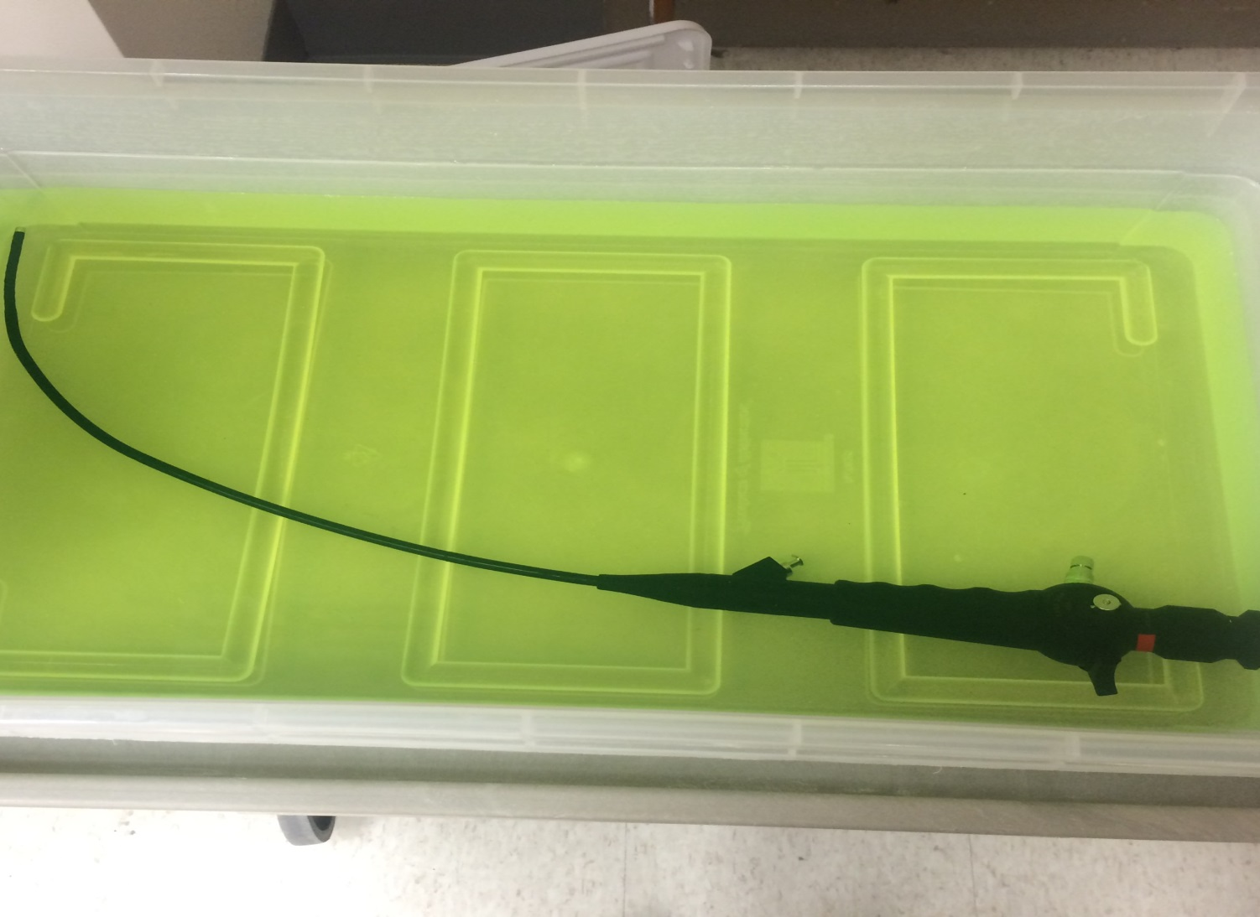
Reprocessing Channeled Endoscopes
Cystoscope- “completely immerse” in HLD (J Urology 2008.180:588)

Slide 24
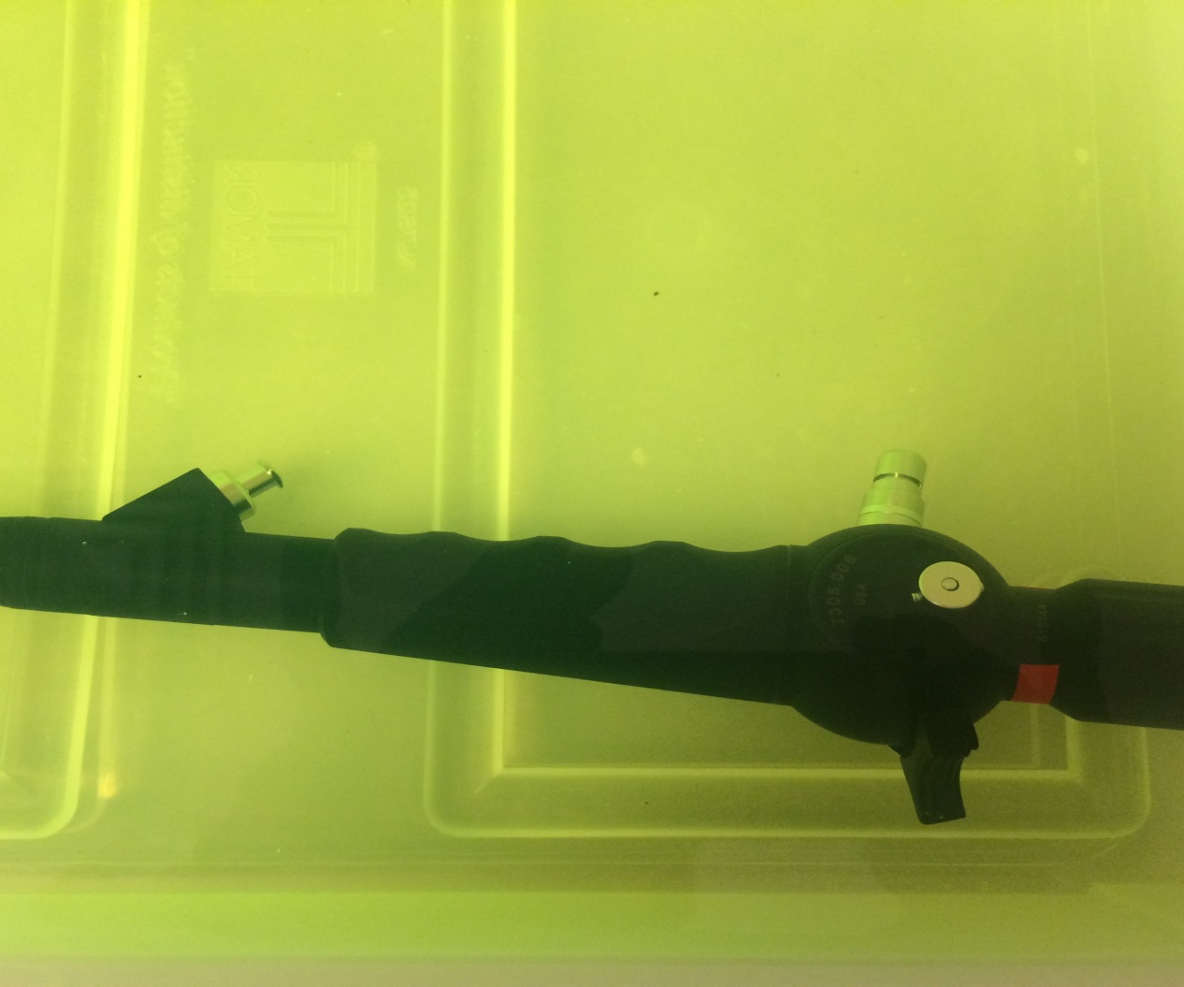
Reprocessing Channeled Endoscopes
Cystoscope-air pressure in channel stronger than fluid pressure at fluid-air interface

Slide 25
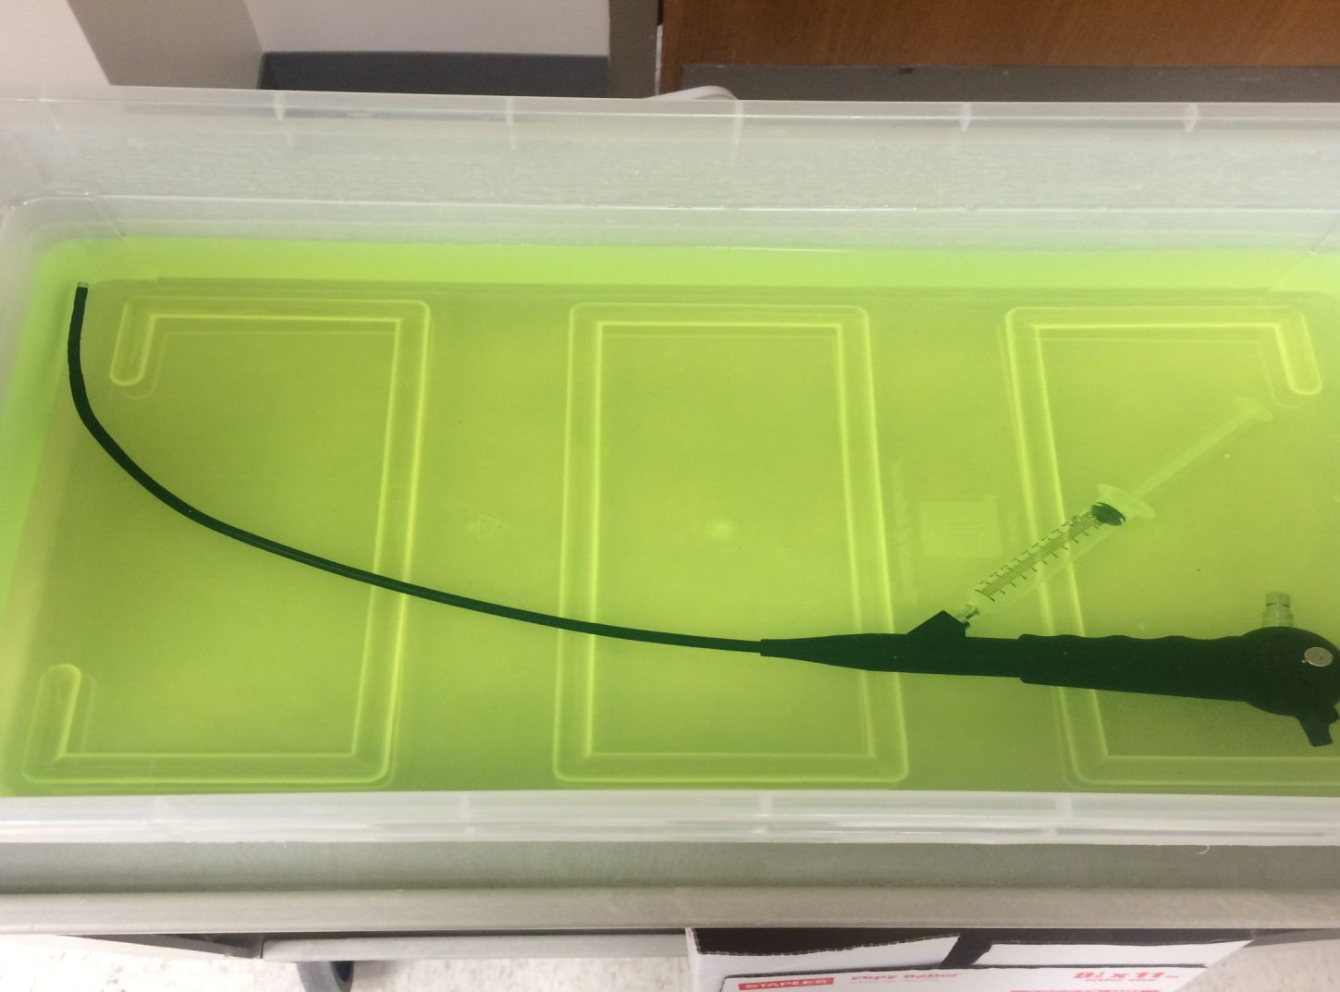
Reprocessing Channeled Endoscopes
Cystoscope-HLD perfused through lumen with syringe (luer locks onto port and syringe filled and emptied until no air exits the scope nor air in barrel of syringe-syringe and lumen filled with HLD)

Slide 26
Reprocessing Channeled Endoscopes
Rutala, Gergen, Bringhurst, Weber. ICHE. In press
Pathogens must have exposure to HLD for inactivation
Immerse channeled flexible scope into HLD will not inactivate channel pathogens
Completely immerse the endoscope in HLD and ensure all channels are perfused
Air pressure in channel stronger than fluid pressure at fluid-air interface
Exposure Method | VRE Contamination Before HLD (glutaraldehyde) | VRE Contamination After HLD
Passive HLD (immersed, not perfused) | 3.6x10⁸ 2.0x10⁸ 1.1x10⁸ | 7.5x10⁸ 1.0x10⁸ 6.8x10⁷
Active HLD (perfused HLD into channel with syringe) | 8.4x10⁷ 1.5x10⁸ 2.8x10⁸ | 1 CFU 0 0

Slide 27
Reprocessing Channeled Endoscopes
Cystoscope-HLD perfused through lumen with syringe (luer locks onto port and syringe filled and emptied until no air exits the scope nor air in barrel of syringe-syringe and lumen filled with HLD)

Slide 28
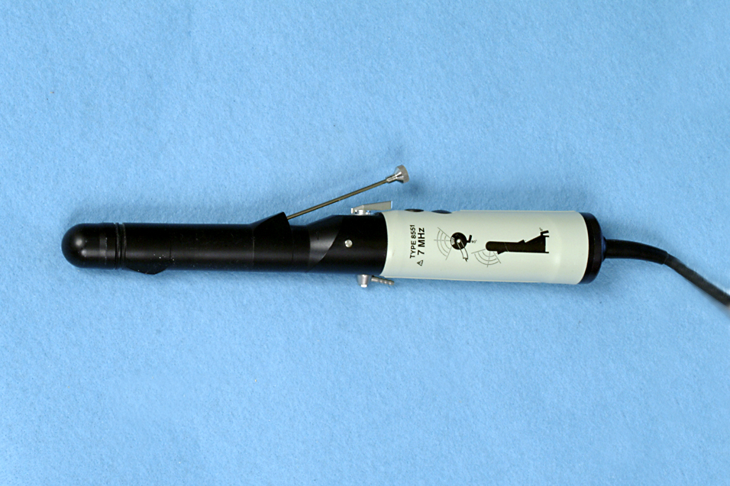

Slide 29
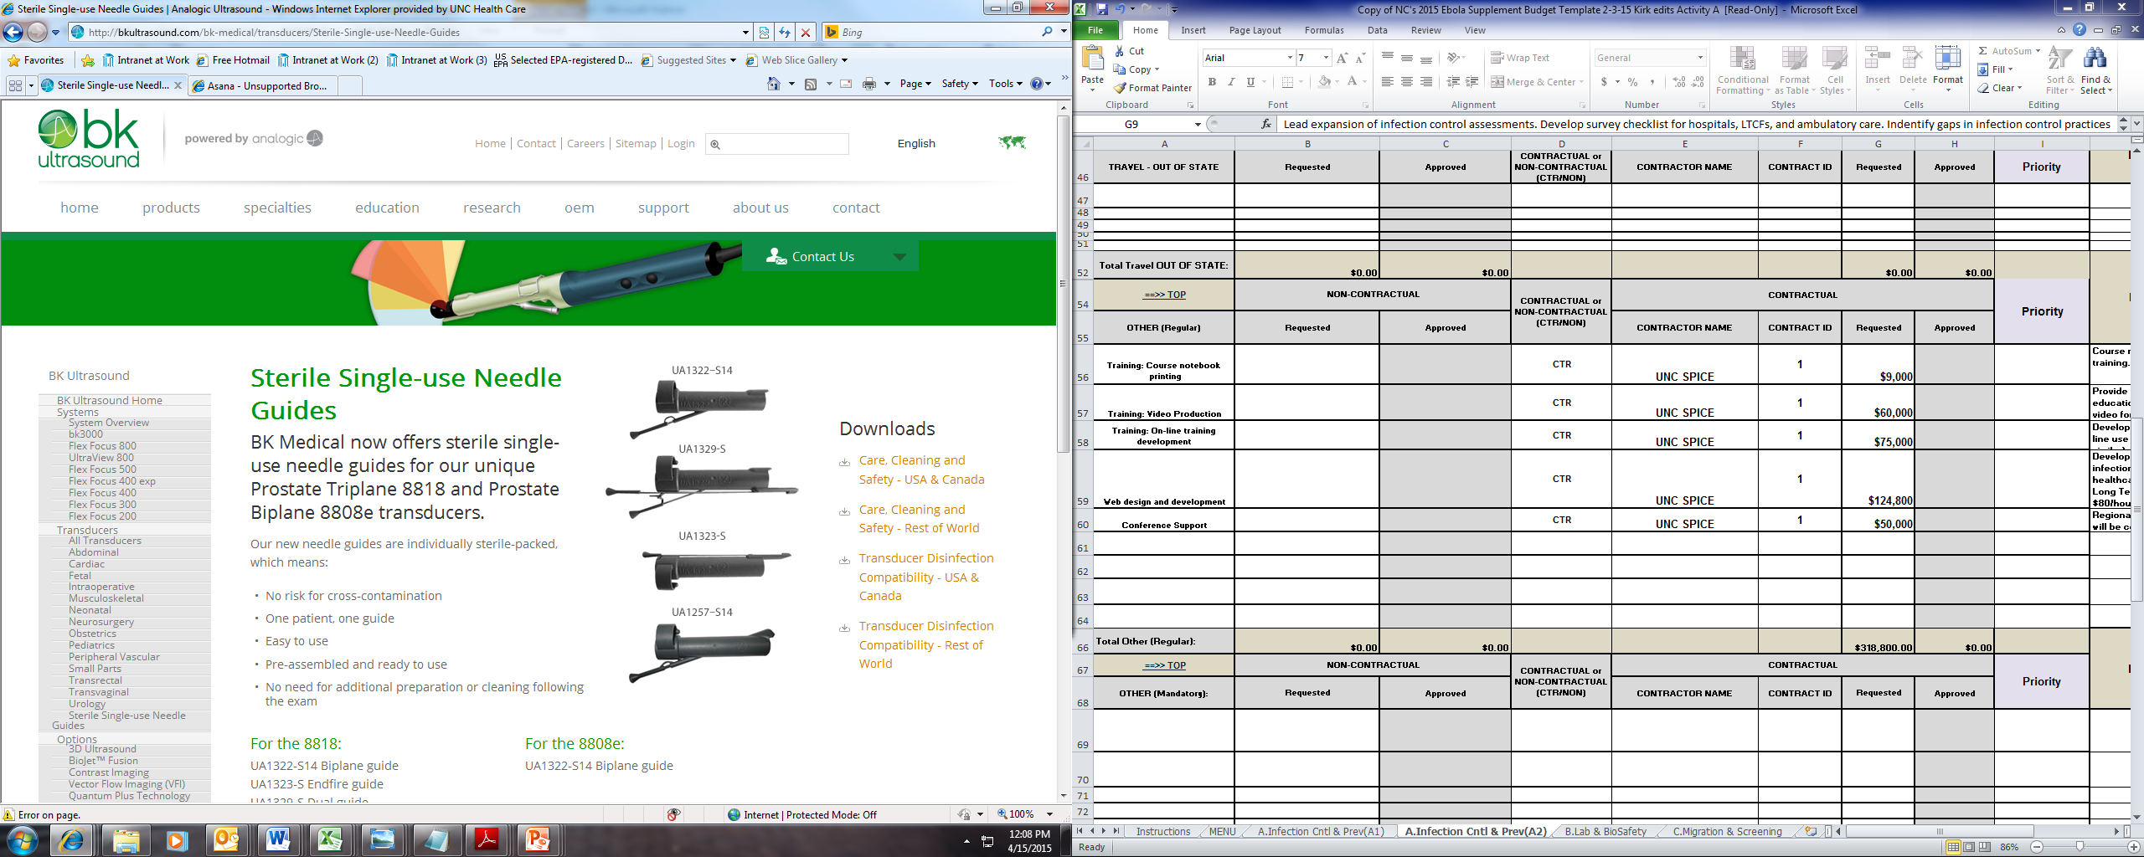
Do Not Reuse Single-Use Devices
Federal judge convicted a urologist who reused needle guides meant for single use during prostate procedures (Sept 2014)
Third party reprocessor OK
Criminal prosecution (based on conspiracy to commit adulteration)

Slide 30
RECENT ENDOSCOPY-RELATED OUTBREAKS OF MRDO WITHOUT REPROCESSING BREACHES
MDRO | Scope | No. | Recovered From Scope | Molecular Link | Reference
P. aeruginosa (VIM-2) | Duodenoscope | 22 | Yes, under forceps elevator | Yes | Verfaillie CJ, 2015
E. coli (AmpC) | Duodenoscope | 7 | Yes (2 scopes) | Yes (PFGE) | Wendort, 2015
K. pneumoniae (OXA) | Duodenoscope | 5 | No |  | Kola A, 2015
E. coli (NDM-CRE) | Duodenoscope | 39 | Yes | Yes (PFGE) | Epstein L, 2014
Additional Outbreaks (not published; news media reports)
UCLA, 2015, CRE, 179 patients exposed (2 deaths), 2 colonized duodenoscopes
CMC, 2015, CRE, 18 patients exposed (7 infected), duodenoscopes
Cedars-Sinai, 2015, CRE, 67 patients exposed (4 infected), duodenoscopes
Wisconsin, 2013, CRE, (5 infected), duodenoscopes
University of Pittsburgh, 2012, CRE, 9 patients, duodenoscopes

Slide 31

Endemic Transmission of Infections Associated with GI Endoscopes May Go Unrecognized
CRE and ESBLs
Inadequate surveillance of outpatient procedures for healthcare-associated infections
Long lag time between colonization and infection
Low frequency of infection
Pathogens “usual” enteric flora
Risk of some procedures might be lower than others (colonoscopy versus ERCP where normally sterile areas are contaminated in the latter)

Slide 32
Reason for Endoscope-Related Outbreaks
Rutala WA, Weber DJ. Infect Control Hosp Epidemiol 2015;36:643-648
Margin of safety with endoscope reprocessing minimal or non-existent for two reasons:
Microbial load
    GI endoscopes contain 10⁷⁻¹⁰
    Cleaning results in 2-6 log₁₀ reduction
    High-level disinfection results in 4-6 log₁₀ reduction
    Results in a total 6-12 log₁₀ reduction of microbes
    Level of contamination after processing: 4 log₁₀ (maximum contamination, minimal cleaning/HLD)
Complexity of endoscope and endoscope reprocessing

Slide 33
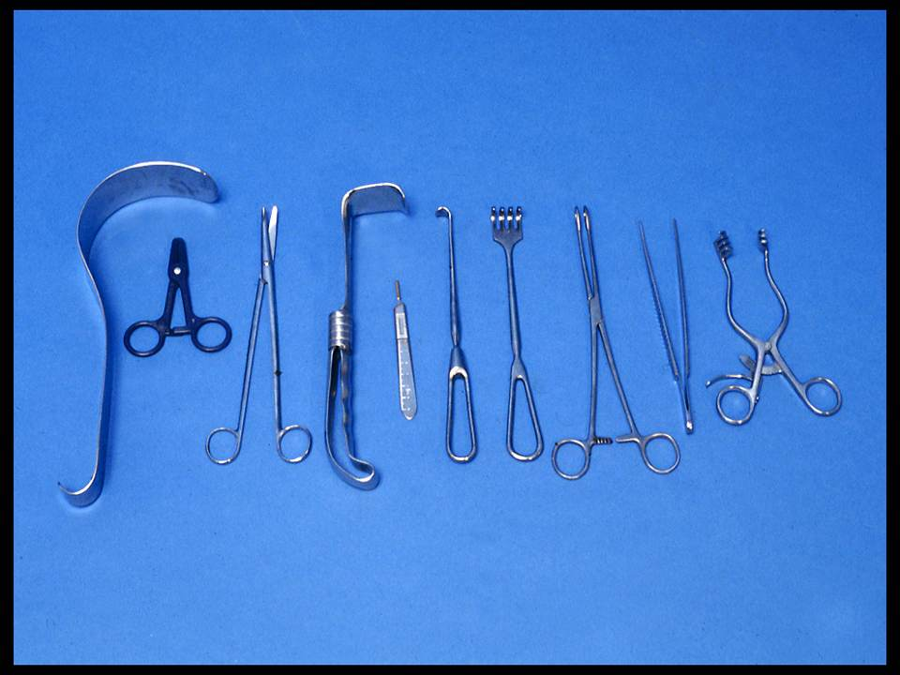
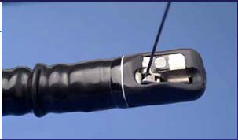
ENDOSCOPE REPROCESSING: CHALLENGES
Surgical instruments-<10² bacteria
Complex [elevator channel]-10⁷⁻¹⁰ bacteria

Slide 34
ENDOSCOPE REPROCESSING: CHALLENGES
NDM-Producing E. coli Associated ERCP
MMWR 2014;62:1051; Epstein et al. JAMA 2014;312:1447-1455
NDM-producing E.coli recovered from elevator channel (elevator channel orients catheters, guide wires and accessories into the endoscope visual field; crevices difficult to access with cleaning brush and may impede effective reprocessing or killing CRE)

Slide 35
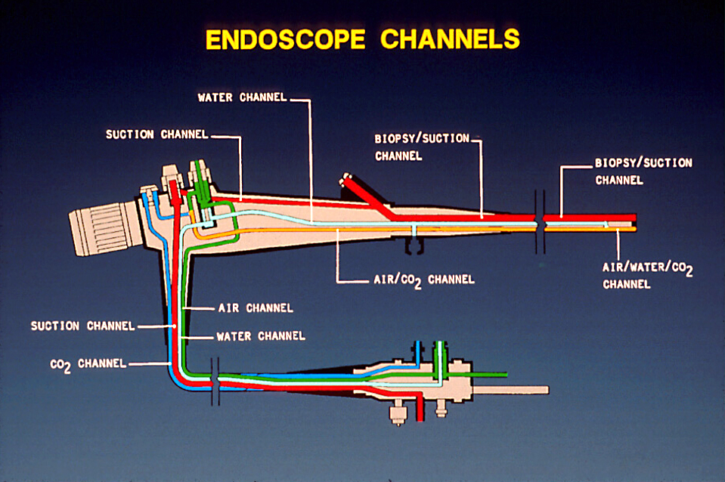
ENDOSCOPE REPROCESSING

Slide 36
FEATURES OF ENDOSCOPES THAT PREDISPOSE TO DISINFECTION FAILURES
Rutala WA, Weber DJ. Infect Control Hosp Epidemiol 2015;36:643-648
Heat labile
Long, narrow lumens
Right angle bends
Rough or pitted surfaces
Springs and valves
Damaged channels may impede microbial exposure to HLD
Heavily contaminated with pathogens, 10⁷⁻¹⁰
Cleaning (4-6 log₁₀ reduction) and HLD (4-6 log₁₀ reduction) essential for patient safe instrument

Slide 37
Reason for Endoscope-Related Outbreaks
Rutala WA, Weber DJ. Infect Control Hosp Epidemiol 2015;36:643-648
Margin of safety with endoscope reprocessing minimal or non-existent
Microbial load
    GI endoscopes contain 10⁷⁻¹⁰
    Cleaning results in 2-6 log₁₀ reduction
    High-level disinfection results in 4-6 log₁₀ reduction
    Results in a total 6-12 log₁₀ reduction of microbes
    Level of contamination after processing: 4log₁₀ (maximum contamination, minimal cleaning/HLD)
Complexity of endoscope
Biofilms-unclear if contribute to failure of endoscope reprocessing

Slide 38
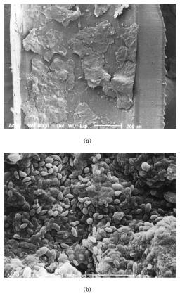
BIOFILMS
(Multi-layered bacteria plus exopolysaccharides that cement cell to surface; develop in wet environments; if reprocessing performed promptly after use and endoscope dry the opportunity for biofilm formation is minimal)

